Slide 1
ConnectPlay
B.E. V SEMESTER MINOR PROJECT (2022-23)

Slide 2
Presented By:
Sadhvik Reddy Vutkur – 160120771046
Sai Sathvik Vadari – 160120771048
Srinivas Patnaik Balivada - 160120771055

Slide 3
Table of contents
01
02
03
Abstract
Problem Statement
Motivation
04
05
06
System Design
Features
Implementation
07
08
Results
Conclusion

Slide 4
“Minds were not built to sit and be taught. They were built to explore, play, and learn.”
- Anonymous

Slide 5
Abstract
“Life is more fun if you play games.” – Roald Dahl.
Games play an essential role in all our lives. We play games not just for entertainment but also to keep the body and mind sharp.
We have observed that many people stop playing a team sport due to the lack of players. The motto of this website is to develop a platform to connect the players to the game.

Slide 6
This way an individual who wants to play a sport can join a pre-existing team who require players, providing a better experience for everyone in that sport. It will pave way to a great environment to make new friendships.
Our open-for-all website also decided to offer slot booking feature for online gaming centres. Many who do not have expensive gaming hardware can always spend some time relaxing by booking a slot in the gaming centre closest to their home and play a game of their choice.
Our website will have 2 interfaces: Admin (to add and edit games) and Player (to book slots and avail features). It is made using MERN architecture.

Slide 7
Problem Statement
People have fallen into their busy schedules and have forgotten the importance of physical activities. Games and sports provide both physical and mental fitness.
How to make sports accessible to all? Such that everyone can connect with each other in order to build better relationships as well as improve team-building mentality.

Slide 8
Motivation
Reasons to choose this topic

Slide 9
After the COVID-19 Pandemic, there has been a dip in the interest in team sports in many children aged 6-17.
According to the research by Utah State University in 2021, an estimated 27.8 % youth have lost interest in organized sports post pandemic.
Key Points
We created this project in order to rekindle the spirit in the youth and bring back the joy and benefits of playing team sports with friends and family.
A platform-based website to connect the players to the game.

Slide 10
Why Sports?
3x
56%
95%
More likely to graduate than non-athletes
of youth ages 6-17 say they “participated on a sports team”
of Fortune 500 executives participated in high school athletics
Source: Women’s Sports Foundation

Slide 11
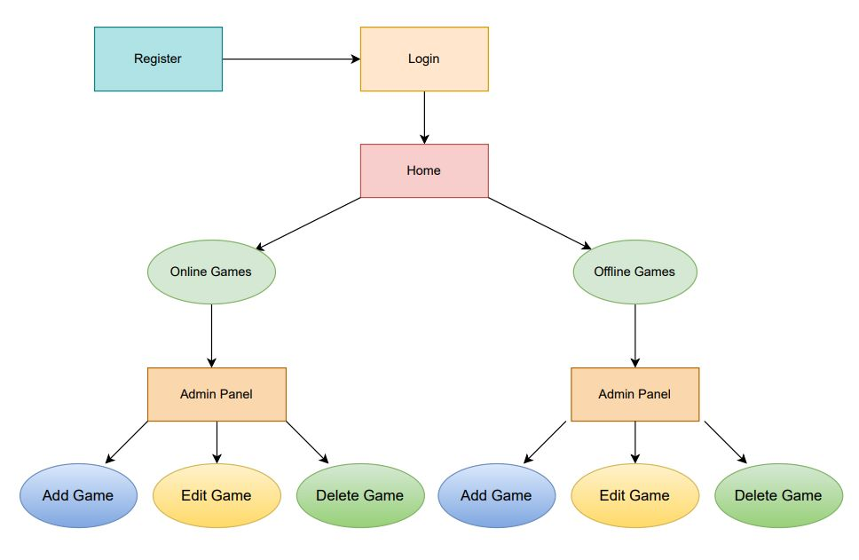
System Design (Admin)

Slide 12
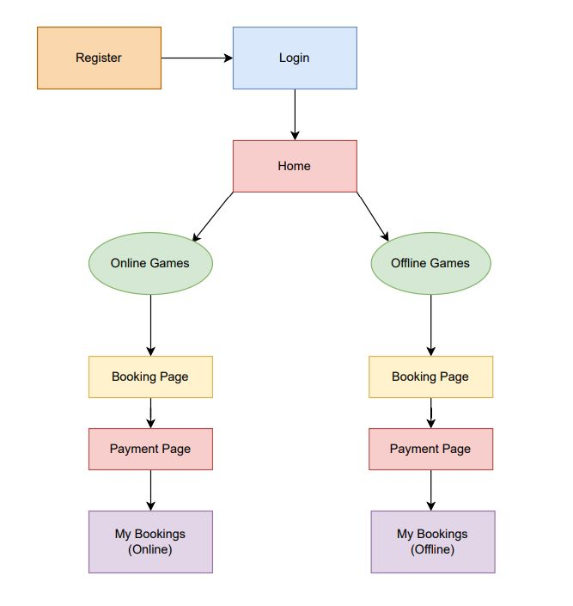
System Design (Player)

Slide 13
Features
Connect
Online
Anyone who wishes to play a team sport can raise a request to connect.
Hassle free set up to have a complete sport experience.
Join
Slot Booking
Interested players can respond to requests and join their game.
E-sports fans can book slots at the nearest gaming center to play their favorite video games.

Slide 14
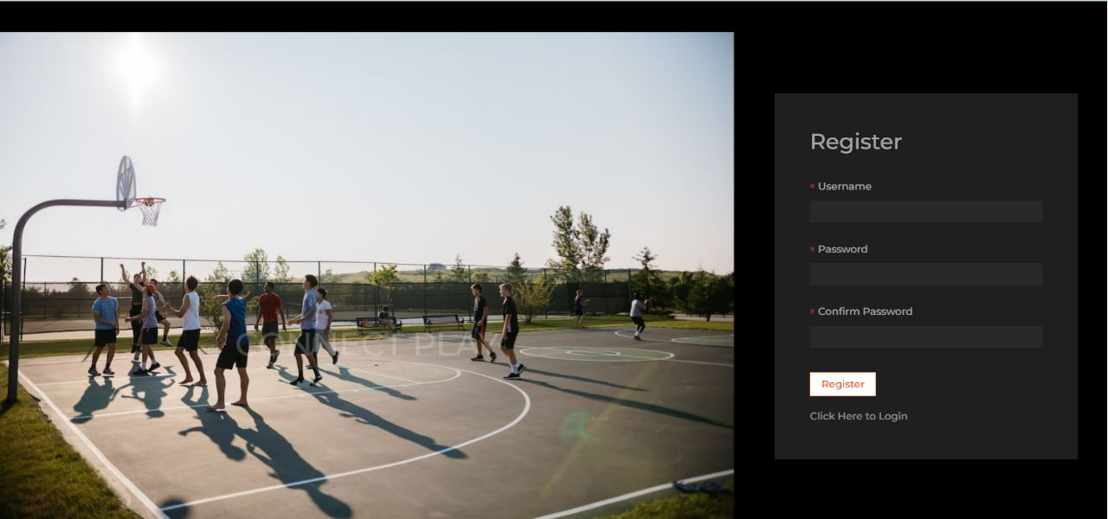
Register Now

Slide 15
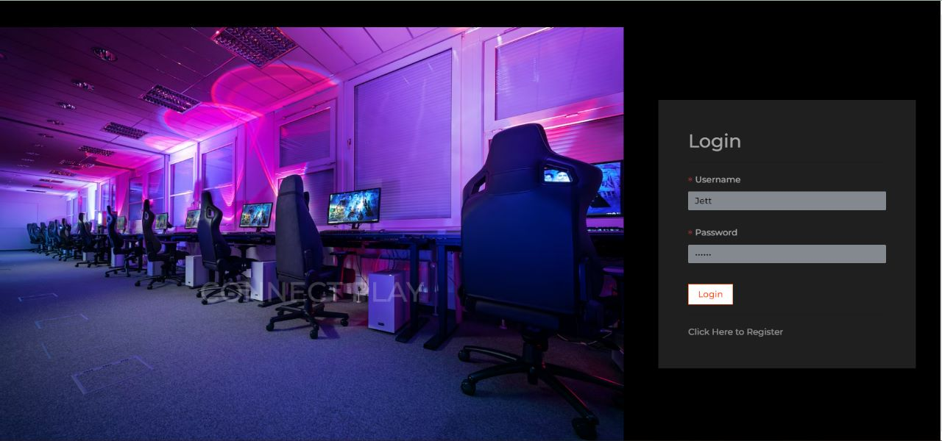
Login

Slide 16
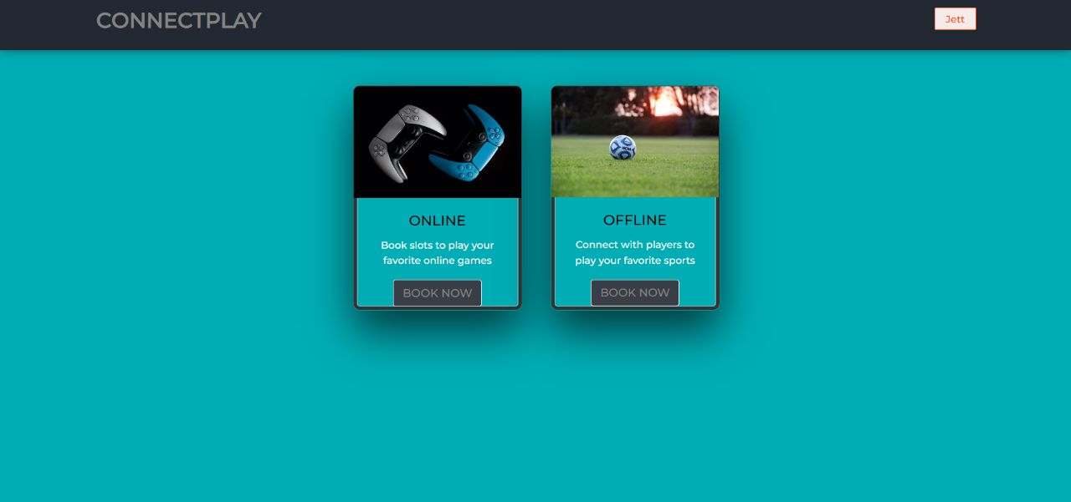
Homepage

Slide 17
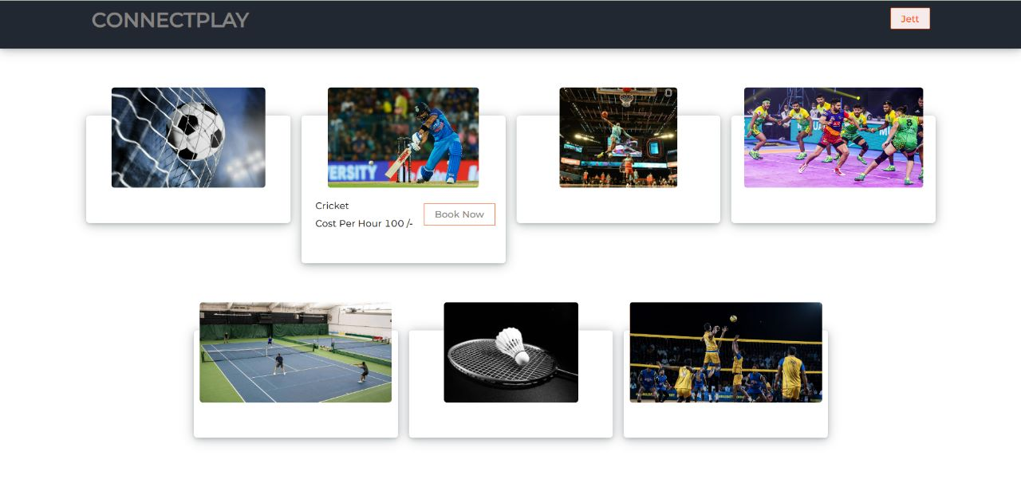
Offline Games Home

Slide 18
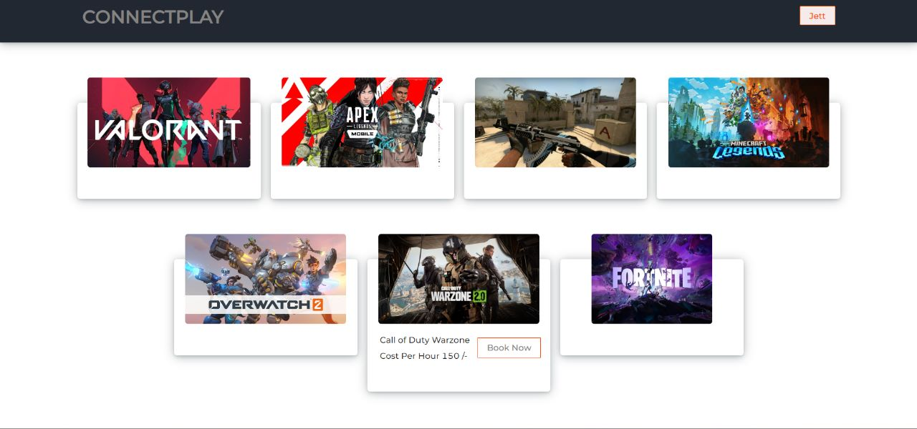
Online Games Home

Slide 19
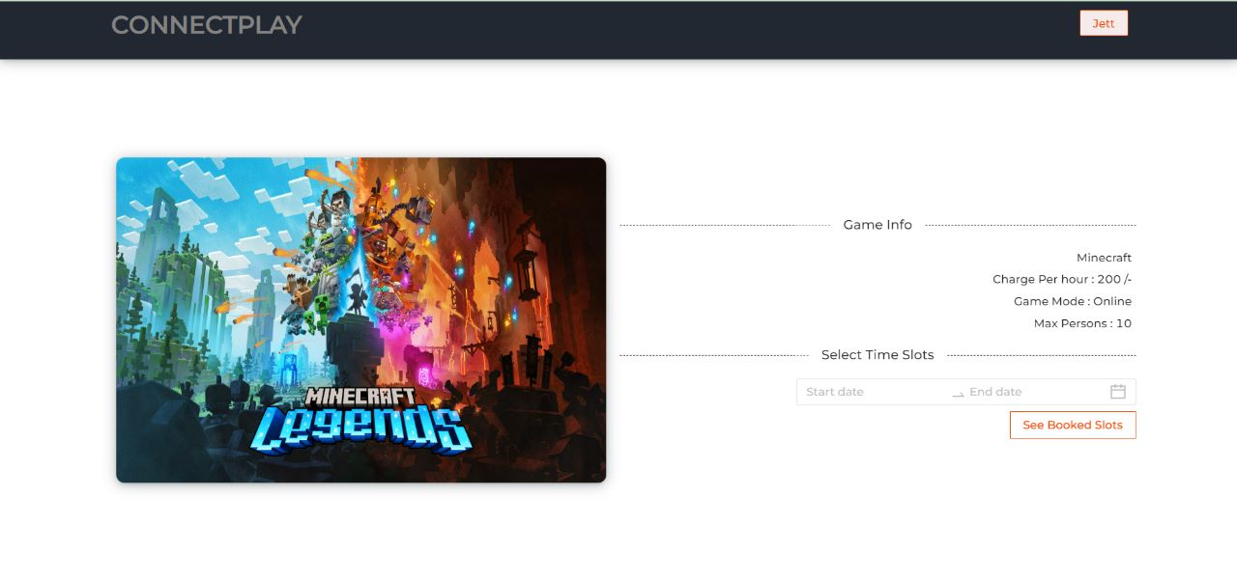
Booking Page

Slide 20
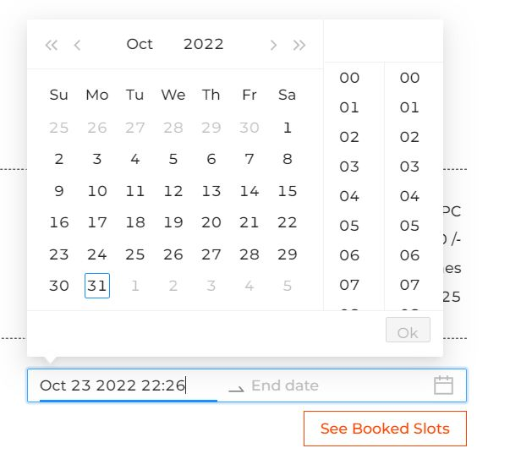
Date and Time Selection

Slide 21
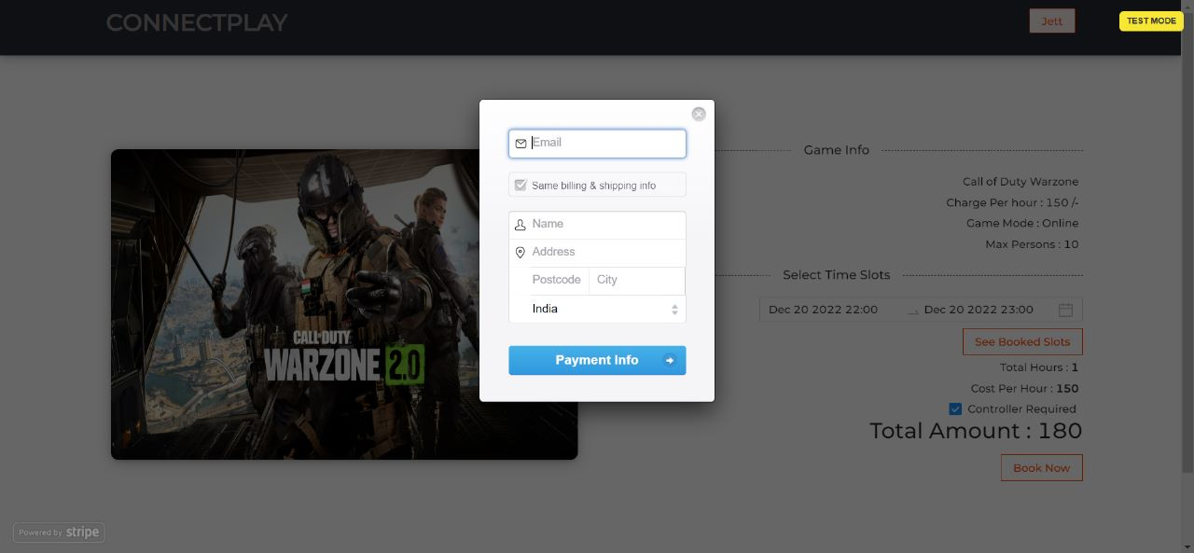
Payment

Slide 22
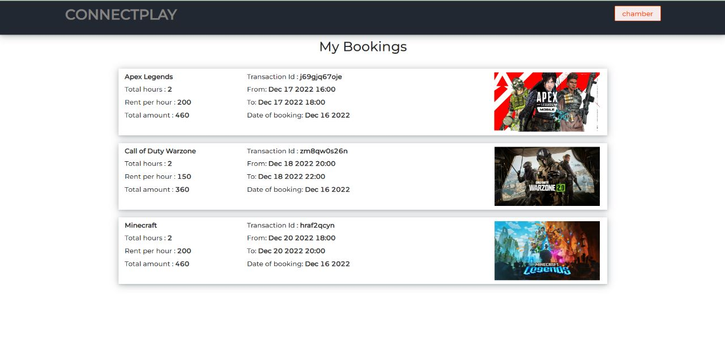
My Bookings

Slide 23
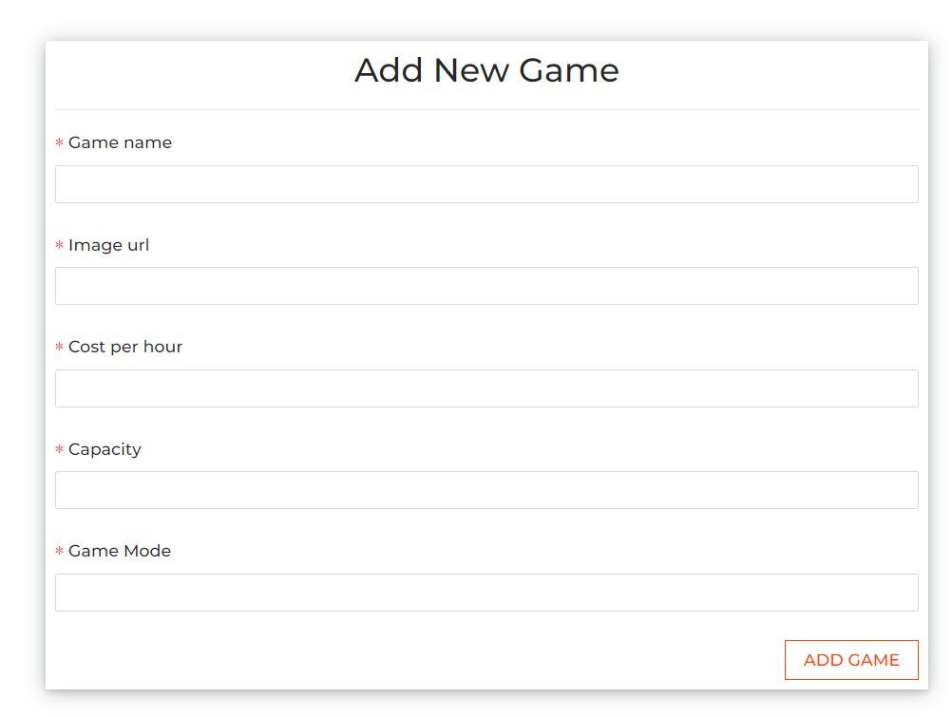
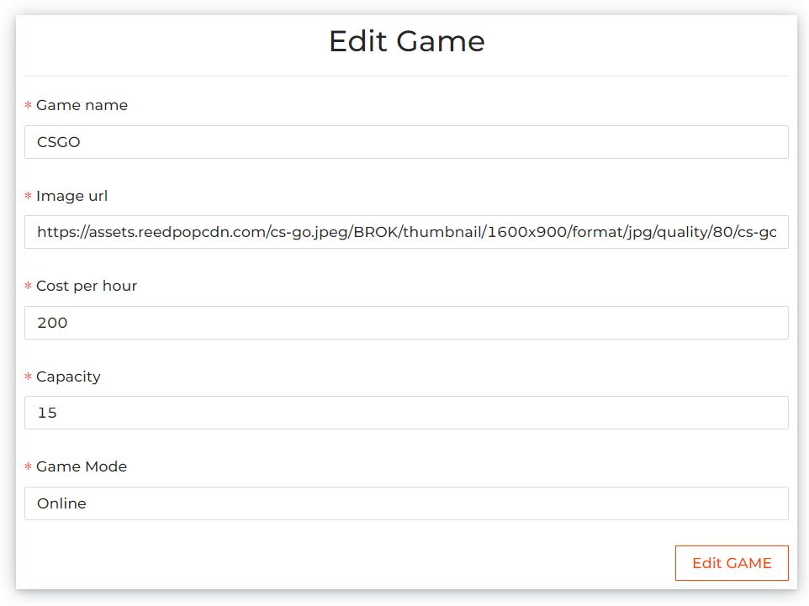
Admin Add/Edit Game

Slide 24
Conclusion
This website makes team sports a great joy again and rekindles friendships. It helps people connect and play in one go.
It also helps people explore new careers and interests in both outdoor and indoor sports.
Through this project we have learnt how to build a successful platform based website with both front-end and back-end functionality using MERN stack.

Slide 25
Thank you

